Slide 1

DIGPASS: A DIGITAL PARKING MANAGEMENT SYSTEM
B.Sc. Computer Science(2022-2025)
Supervisor : Mrs. T. PANDIYAVATHI
Designation : Assistant Professor (Sr.Gr.)
Student Name 1 : ANGELIN GRACY. R
(221371601006)
Student Name 2 : HARINI.R
(221371601018)
DEPARTMENT OF COMPUTER APPLICATIONS

Slide 2
INTRODUCTION
A college vehicle pass system is a crucial tool for striking a balance between accessibility, security and efficiency in a busy campus environment.
In order to guarantee that only authorized students, instructors, staff or guests are permitted to park or enter campus premises with their automobiles, a college must establish an organized system for vehicle passes.
Effective parking spot organization, safety maintenance and a decrease in illegal entry are all made possible by a college vehicle pass management system.
DEPARTMENT OF COMPUTER APPLICATIONS

Slide 3
ABSTRACT
Effective parking management on college campuses is becoming more and more crucial as the number of automobiles on campus rises.
This project suggests creating a mobile-based vehicle pass system that makes it simple for staffs and students to acquire and administer vehicle passes for campus access.
Users will be able to apply for passes, register vehicle details and obtain digital campus security approval through an easy-to-use interface.
The system will produce one-of-a-kind digital passes that may be presented for validation at access points.
Through the use of contemporary mobile technology, this seeks to improve campus traffic management, decrease paperwork, increase security and expedite the vehicle entry process.
This digital approach eliminates the need for physical passes and simplifies administrative tasks, offering an efficient, environmentally friendly solution for campus access control.
DEPARTMENT OF COMPUTER APPLICATIONS

Slide 4
OBJECTIVE
The key objectives of the vehicle pass management system are:
Develop a web-based system for digital vehicle pass issuance and management.
Enhance security by implementing authentication and access control mechanisms.
Provide real-time monitoring of car entry, exit and parking bay utilization.
Automate the approval process to reduce administrative workload.
Allocate a parking slot for each individuals to avoid traffic.
Ensure user-friendly access for students, faculty and security personnel
DEPARTMENT OF COMPUTER APPLICATIONS

Slide 5
PROBLEM IDENTIFIED
Error-Prone Data Entry: Manual data entry can lead to errors and inconsistencies in pass records
Lost or Damaged Passes: Physical passes can be lost, damaged or stolen, leading to security breaches and unauthorized vehicle access.
Long Wait Times: Manual pass issuance can lead to long wait times for users.
Lack of Encryption: Manual passes may lack encryption, making it easy for unauthorized individuals to access sensitive information.
Lack of Automated Reminders: Manual pass management lacks automated reminders, which can lead to expired passes and fines.
Non-Compliance: Manual pass management can lead to non-compliance with regulations, resulting in fines and penalties.
DEPARTMENT OF COMPUTER APPLICATIONS

Slide 6
LITERATURE SURVEY
TITLE | YEAR | AUTHORS | FINDINGS
An Android based Smart Bus Pass Application | 2024 | Sivakani, Gandhi, Manikandan, Vaidianathan | Using smart phone app students can enroll for the bus pass online
Bus Pass Booking System | 2024 | Sanjay WayKar, Umema Bhatkar, Tejas Jaiswal, Tithi Nayek, Ayesha Pathan | Revolutionize the traditional method of obtaining bus passes by secure online platform
Digital Out Pass System | 2023 | G. Sriram Ganesh, CH. Navya Anusha, G. Venkata Sowmya, K. Devi Mahendra, K. Rishik Reddy, G. Durga Harshitha | The project aims to provide a user-friendly and efficient system for monitoring student activities, both within the campus and in the hostels.
Hostel Management and Logistics | 2023 | Shruti Patil, Bandari Sai Krishna, K. Sai phani Goud, Ayesha Fatima, Alumala Praneeth Reddy, D. Shivamani | This is a website that provides completely digitalized dormitory registration, it also helps us in tracking the check-in and check-out time stamps of each student using their face recognition as an identity.
DEPARTMENT OF COMPUTER APPLICATIONS

Slide 7
LITERATURE SURVEY
TITLE | YEAR | AUTHORS | FINDINGS
Vehicle Entry Management System Using Image Processing | 2022 | R.Vallikannu, Krishna kanth, L. SaiPavan Kumar, Monisha, and Karthik | The project aims to implement a system to check the entry status of the vehicle automatically. The verification process is based on there cognition of the number plate of the vehicle by using image processing based on OpenCV and Raspberry pi, comparing with the pre-existing stored information in the database.
Gate pass management system using Android (App) | 2021 | Prerana khandekar, Vaishnavi patil, Vikas solanke | The Project 'Gate-pass Management System' is to record the details and various activities of the user and We are providing the electronic version of the paper gate pass. We provide appropriate training to the security guard to handle gate pass application.
Railway Management System | 2020 | Shubhangi D.C, Aishwarya B.K | To manage this large network we make use of the PRS system which provides the facility to book the tickets to travel across the country even of it’s the small distance of the largest distance.
DEPARTMENT OF COMPUTER APPLICATIONS

Slide 8
LITERATURE SURVEY
TITLE | YEAR | AUTHORS | FINDINGS
Automatic e-ticketing and Vehicle Parking System | 2019 | Viknesh, Swaminathan, Mahakaleshwar, Anju S Pillai | To develop a good mobility for transport with efficient car parking Management System
Cloud based Bus Pass System | 2018 | Vivek Reddy,Krishna Venkatesh,Praveen Kumar,Abhinay Rao | This online bus pass registration application will help candidates to save their time and renewal bus pass without standing in a line for hours near counters.
Android App for Hostel Outpass Form | 2017 | Mary Shalin Benigna | to create a full-fledged Android application which could help the students to fill an out pass form and get approval from the consent staff and coordinators at one click.
DEPARTMENT OF COMPUTER APPLICATIONS

Slide 9
BASE PAPER
BASE PAPER TITLE: Gate Pass Management System Using Arduino and RFID
AUTHORS: Kaviya and Rajarajan
YEAR: 2024
OBJECTIVE: To design and implement an automated gate pass management system that leverages RFID technology and Arduino to efficiently track and control the entry and exit of authorized personnel or vehicles. The system aims to enhance security, streamline access control and provide real-time monitoring and reporting of gate pass usage.
LIMITATION: The major limitations are short range of RFID systems, lack of strong security features, limited processing power and memory of Arduino board and power consumption also be concerned.
DEPARTMENT OF COMPUTER APPLICATIONS

Slide 10
EXISTING SYSTEM
Gather Required Documents: Vehicle registration certificate, Insurance certificate, Driver's license, College ID (for students and staff), Proof of address (for visitors)
Fill Out Pass Application Form: Provide vehicle details (model, number), Provide owner's details (name, contact information), Specify purpose of visit and Provide duration of stay (for visitors)
Pay Pass Fee: Determine pass type (daily, weekly, monthly), Calculate pass fee based on pass type, Accept payment (cash, Check, online)
Create Manual Pass: Use a template or design a manual pass, Include pass details (vehicle number, owner’s name, pass type, validity period)
Issue Manual Pass: Hand over the manual pass to the vehicle owner
Record Pass Issuance: Keep a record of all manual passes issued
Verify Pass Validity: Check pass validity period
DEPARTMENT OF COMPUTER APPLICATIONS

Slide 11
EXISTING SYSTEM
LIMITATIONS OF EXISTING SYSTEM:
The system may not support real-time tracking of available parking slots without IoT integration.
Works best in environments with controlled access; open or informal parking areas may not benefit fully.
Does not include automated number plate recognition (ANPR) for vehicle validation. Limited adaptability to dynamic pricing models or multi-level parking zones.
Pass generation is digital but lacks biometric or advanced security authentication.
Does not support multilingual interfaces for users from diverse backgrounds.
The system relies heavily on accurate user input; incorrect details may lead to slot mismanagement.
DEPARTMENT OF COMPUTER APPLICATIONS

Slide 12
EXISTING SYSTEM
DRAWBACKS OF EXISTING SYSTEM:
Limited scalability for very large parking infrastructures or smart cities without additional optimization.
System performance may degrade under high user load if not properly optimized.
Dependency on internet connectivity for real-time updates and pass verification.
Manual slot type categorization may lead to incorrect slot assignment without automated vehicle detection.
Admin verification or validation may become a bottleneck without automation or AI support.
Payment system may face issues with third-party gateway failures or latency.
DEPARTMENT OF COMPUTER APPLICATIONS

Slide 13
PROPOSED WORK
Register Vehicle Owner: Vehicle owner submits registration request through online portal, Owner provides required documents, System verifies documents and creates owner profile.
Apply for Digital Pass: Vehicle owner logs in to online portal, Owner applies and System calculates pass fee and displays payment options.
Make Payment: Vehicle owner selects payment method (online payment, credit/debit card)- System processes payment and updates owner profile.
Generate and provide Digital Pass: System generates unique digital pass ,Pass includes vehicle details and owner details and pass validity period, System sends digital pass to the owner. Then Vehicle owner displays digital pass on mobile device.
Verify Digital Pass: System verifies pass validity and owner details- Security personnel allow or deny vehicle entry based on pass validity.
Manage Digital Pass: System tracks and manages all digital passes issued- System sends reminders for pass renewal or expiration- System allows owners to update pass details or cancel passes
DEPARTMENT OF COMPUTER APPLICATIONS

Slide 14
PROPOSED SYSTEM
MERITS OF PROPOSED SYSTEM:
24/7 Availability
Owners can apply, pay, and manage passes at any time from anywhere using the online portal.
2. Paperless & Eco-friendly
Fully digital system eliminates the need for physical paperwork.
Digital passes reduce plastic or paper pass issuance.
3. Real-Time Updates & Management
Owners receive timely reminders for pass renewals or expiration.
System allows owners to update or cancel passes without hassle.
DEPARTMENT OF COMPUTER APPLICATIONS

Slide 15
PROPOSED SYSTEM
4. Cost-Effective
Reduces administrative costs related to printing, manual handling and physical infrastructure.
5. Digital Pass Generation:
E-Passes sent via email ensure contactless access and verification.
6. User-Friendly Interface:
React-based frontend provides a responsive and intuitive user experience for both internal and external users.
7. Environmentally Friendly:
Reduces the need for printed tickets or passes.
DEPARTMENT OF COMPUTER APPLICATIONS

Slide 16
METHODOLOGY
Gathered user and system requirements through stakeholder analysis.
Analyzed system functionalities and user workflows for clarity.
Selected modern technology stack including ReactJS, Node.js, MongoDB, Razorpay and Nodemailer.
Designed the application architecture using a component-based development model.
Divided the system into functional modules for effective development and maintenance.
Developed user interfaces with ReactJS ensuring responsiveness and usability.
Implemented backend services and RESTful APIs using Node.js and Express.js
Integrated payment gateway for secure online transactions.
Configured email services for e-pass generation and notifications.
Documented the entire system architecture, functionalities and usage flow.
DEPARTMENT OF COMPUTER APPLICATIONS

Slide 17
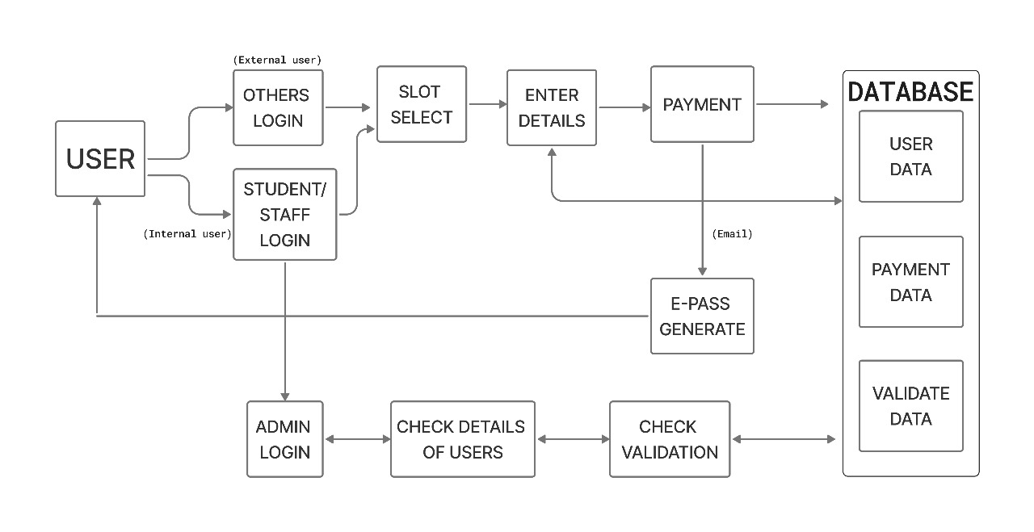
ARCHITECTURE DIAGRAM
DEPARTMENT OF COMPUTER APPLICATIONS

Slide 18
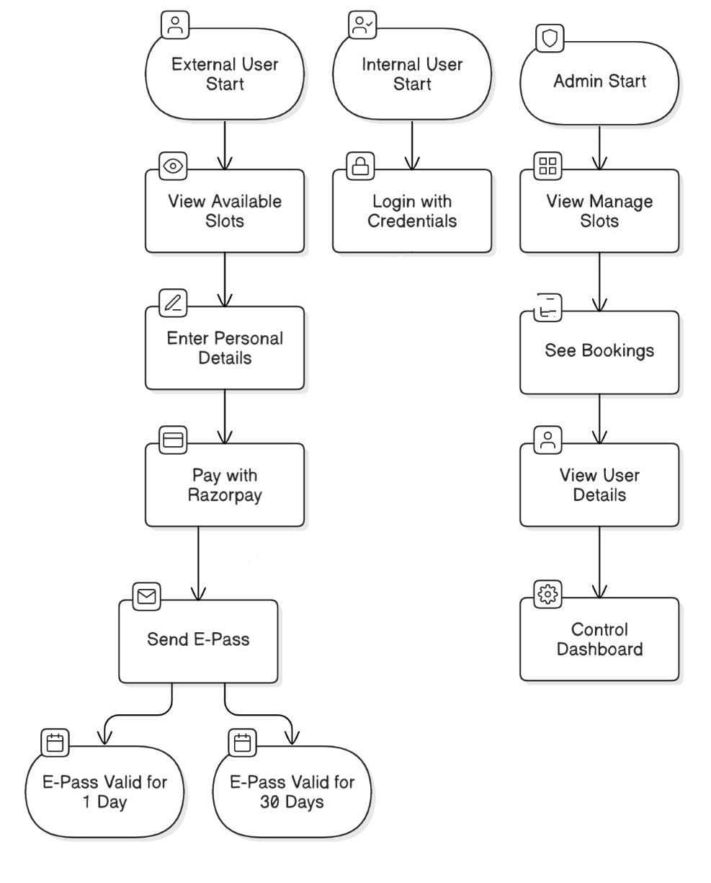
DATA FLOW DIAGRAM
DEPARTMENT OF COMPUTER APPLICATIONS

Slide 19
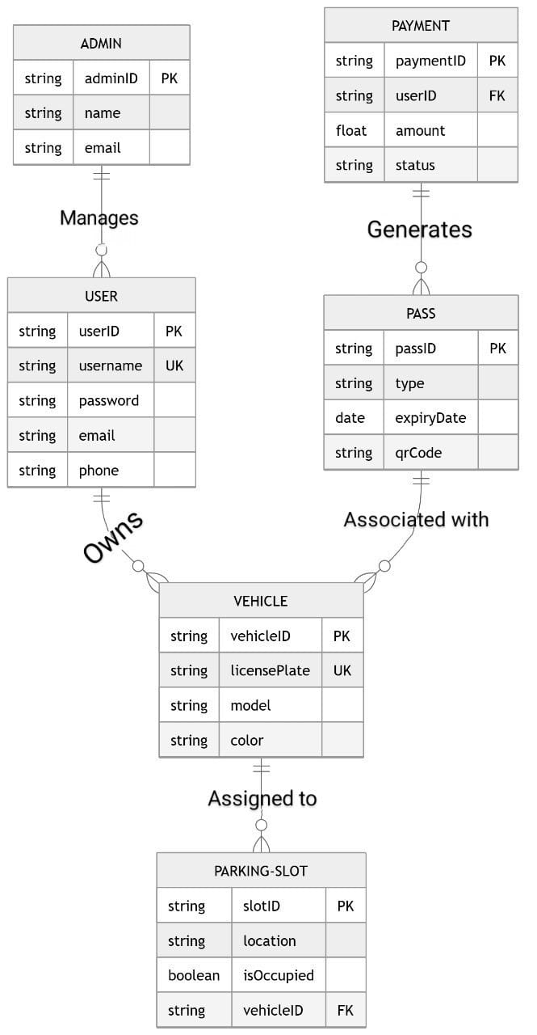
ER DIAGRAMS
DEPARTMENT OF COMPUTER APPLICATIONS

Slide 20
MODULE IMPLEMENTATION
MODULE 1: USER AND SLOT MANAGEMENT MODULE
This module facilitates both user access and parking slot management. It handles user interaction for both internal (staff/students) and external users, including login for internal users and seamless navigation for external users. The module also provides an intuitive slot booking interface with real-time availability.
User Interface:
Internal Users: Staff/Student login with credentials
External Users: Direct access to slot booking.
2. User Details Entry:
Name, Email, Vehicle Number form submission.
DEPARTMENT OF COMPUTER APPLICATIONS

Slide 21
MODULE IMPLEMENTATION
The Slot Selection Module is a core component of the DIGPASS system that enables users to view, choose and reserve available parking slots based on real-time availability. This module is designed to streamline the user experience while ensuring optimal utilization of parking resources.
Slot Management:
Display of slot grid (available, booked, reserved)
Real-time slot selection and status update
Prevent double booking through backend validations
DEPARTMENT OF COMPUTER APPLICATIONS

Slide 22
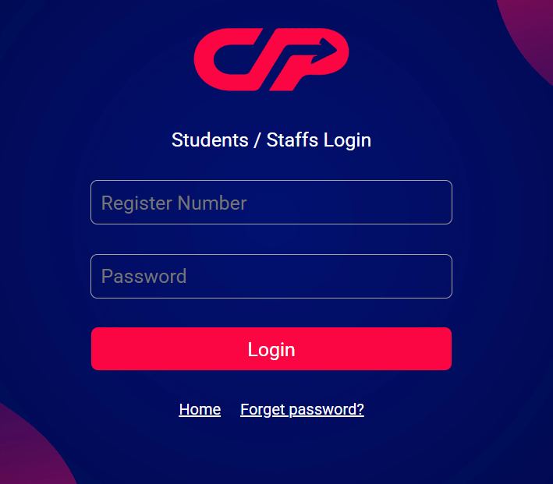
MODULE IMPLEMENTATION
DEPARTMENT OF COMPUTER APPLICATIONS

Slide 23
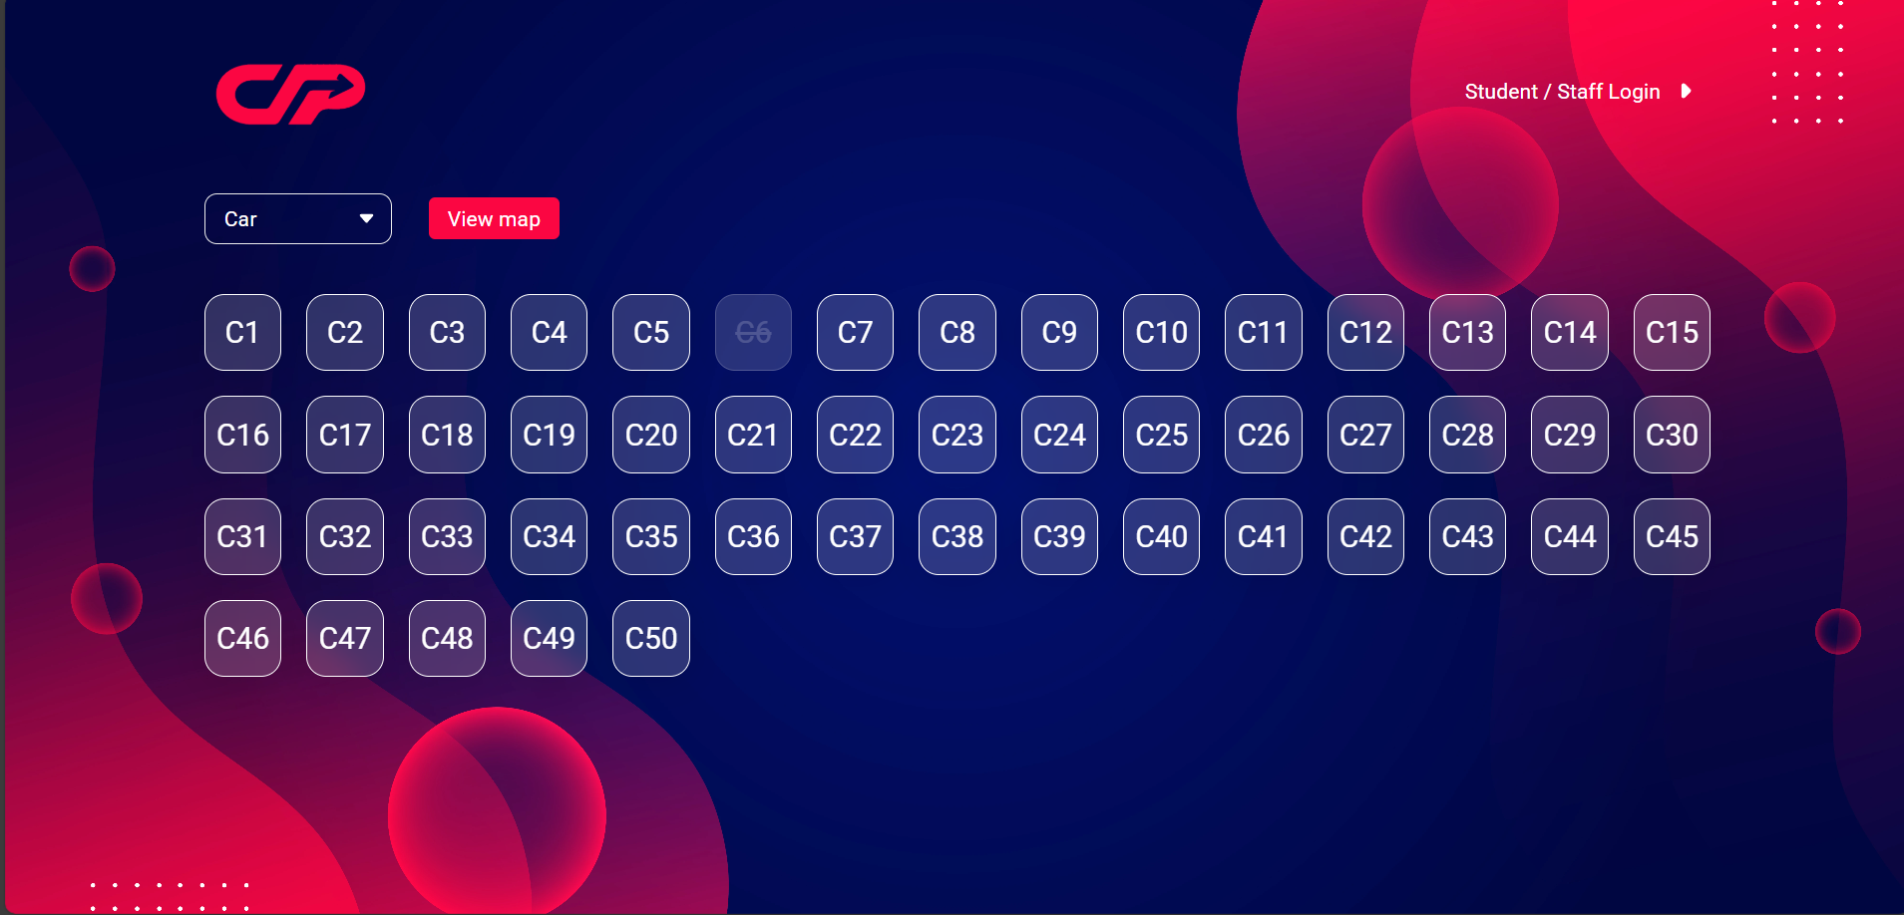
MODULE IMPLEMENTATION
DEPARTMENT OF COMPUTER APPLICATIONS

Slide 24
MODULE IMPLEMENTATION
MODULE 2: PAYMENT MODULE
This module ensures secure, efficient payment processing for slot bookings. It calculates the total amount based on booking duration and type and integrates with a payment gateway to process transactions.
Payment gateway integration
Fee calculation based on:
Slot type (Car/Bike)
Duration of booking
3. Payment confirmation and handling
4. Redirection to post-payment flow
DEPARTMENT OF COMPUTER APPLICATIONS

Slide 25
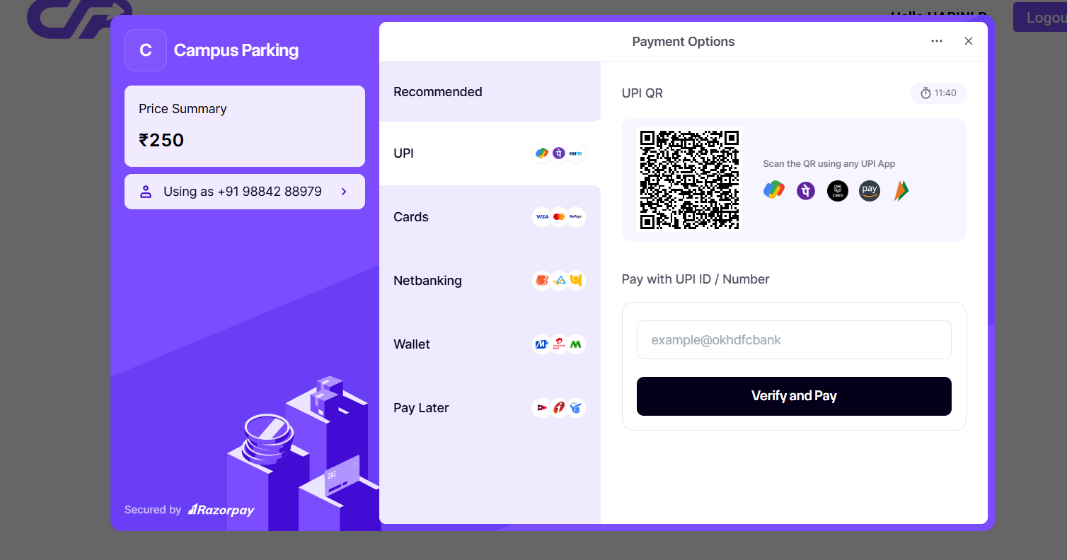
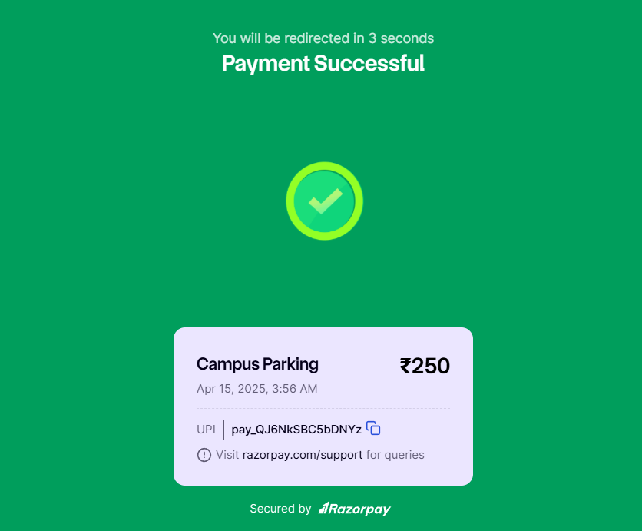
MODULE IMPLEMENTATION
DEPARTMENT OF COMPUTER APPLICATIONS

Slide 26
MODULE IMPLEMENTATION
MODULE 3: NOTIFICATION AND E-PASS GENERATION
Once the payment is successful, this module is responsible for notifying the user and generating an electronic parking pass (E-pass). The E-pass is used for validation at the parking entry point.
Display of payment success message
Generation of a digital E-pass
Sending E-pass via email
Store E-pass data for admin and user reference
DEPARTMENT OF COMPUTER APPLICATIONS

Slide 27
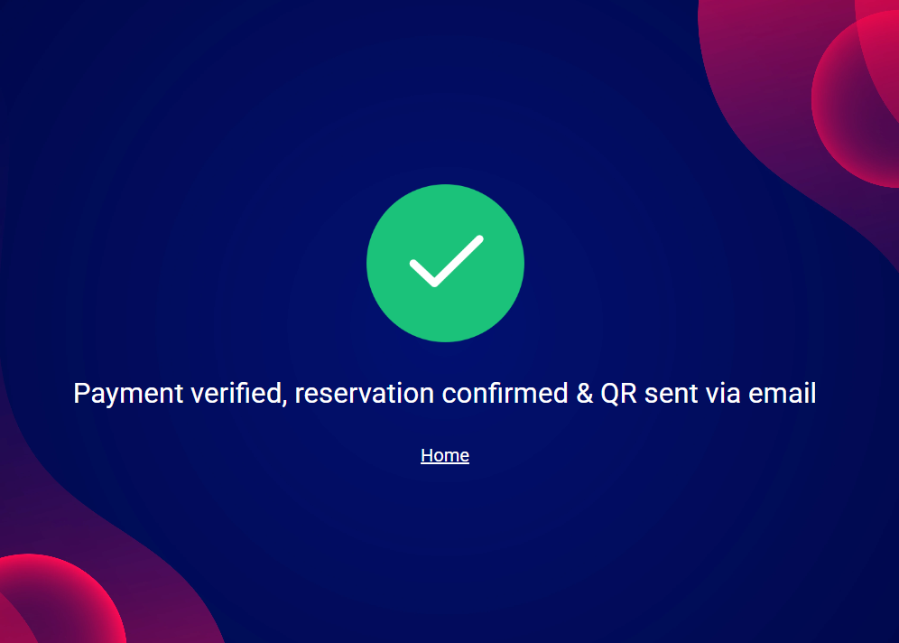
MODULE IMPLEMENTATION
DEPARTMENT OF COMPUTER APPLICATIONS

Slide 28
MODULE IMPLEMENTATION
MODULE 4: ADMIN AND VALIDATION MODULE
This module provides administrative controls for viewing and managing all user bookings and system data. It also supports validation through QR or keyword-based verification, ensuring secure entry based on valid bookings.
Admin login and dashboard
View and filter all bookings by user type, date and status
Keyword/QR scanner to validate E-pass at the entry gate
Monitor internal and external user activity
Manually approve, reject or flag suspicious entries
DEPARTMENT OF COMPUTER APPLICATIONS

Slide 29
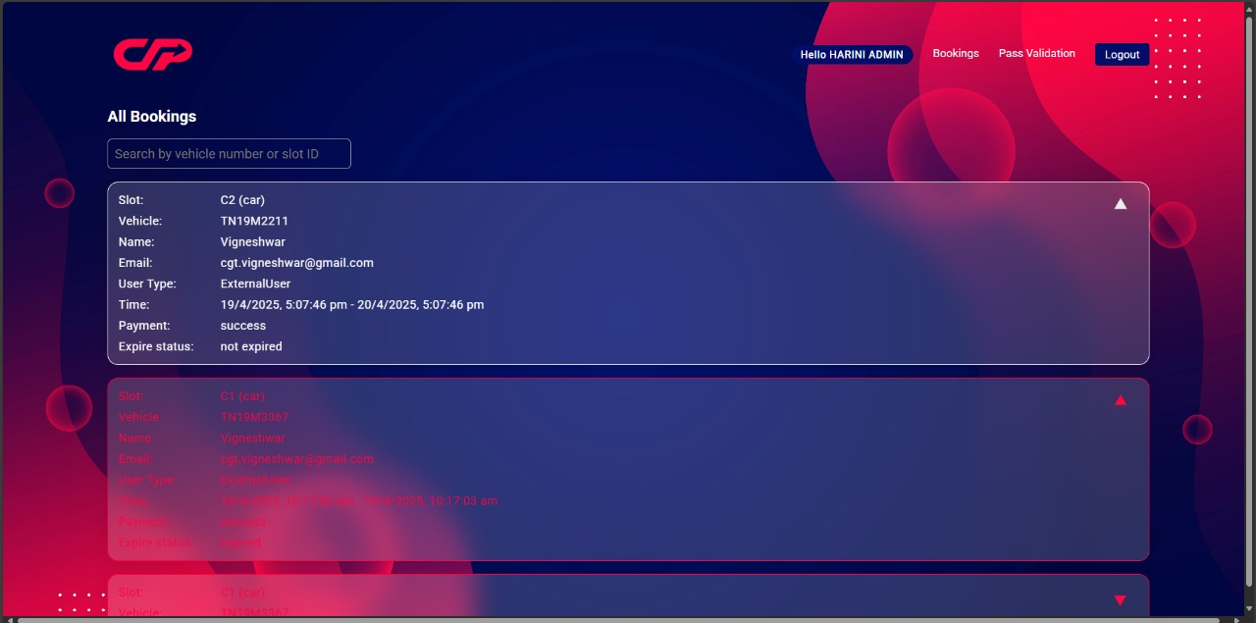
MODULE IMPLEMENTATION
DEPARTMENT OF COMPUTER APPLICATIONS

Slide 30

MODULE IMPLEMENTATION
DEPARTMENT OF COMPUTER APPLICATIONS

Slide 31
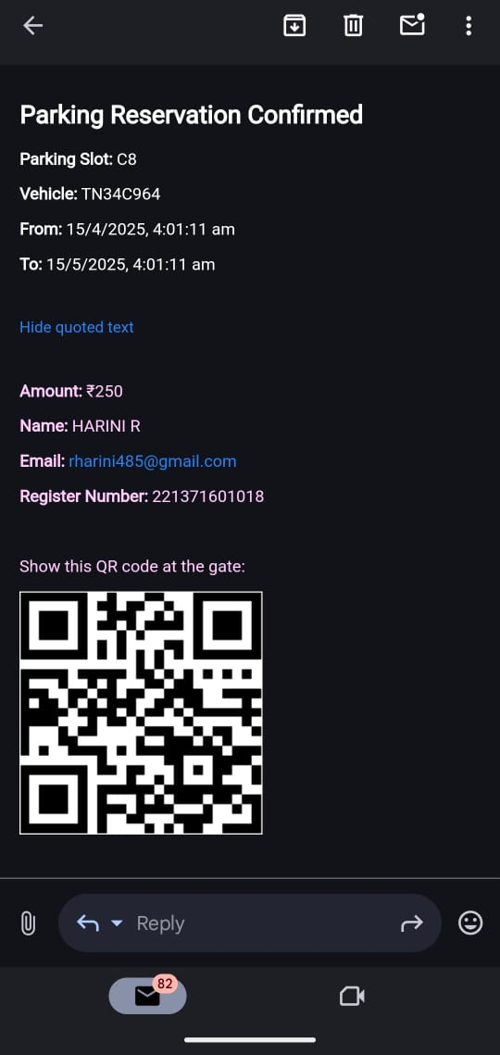
IMPLEMENTATION
DEPARTMENT OF COMPUTER APPLICATIONS

Slide 32
RESULT AND ANALYSIS
QUALITATIVE RESULTS:
The interface is user-friendly and easy to navigate.
Booking slots is quick and straightforward.
E-passes are generated and sent automatically via email.
Slot availability is updated in real time.
Payments are secure and integrated through Razorpay.
Role-based access ensures proper control for different users.
Admins can efficiently manage slots and user data.
The backend is stable and responsive under load.
Users gave positive feedback on overall experience.
The system is scalable and easy to maintain for future updates.
DEPARTMENT OF COMPUTER APPLICATIONS

Slide 33
CONCLUSION AND FUTURE SCOPE
CONCLUSION:
DigPass: A Vehicle Parking Management System is a comprehensive solution designed to streamline and digitize the management of parking facilities for internal and external users. By incorporating modules such as user authentication, slot management, payment integration, real-time notifications, e-pass generation and administrative validation, the system significantly improves user experience and operational efficiency.
The system enables users to book parking slots in advance, make secure payments and receive digital passes with ease. The admin panel facilitates real-time monitoring, validation and effective resource allocation. With a centralized database, all critical data including user details, vehicle information, slot availability and transaction records are managed securely and efficiently.
DEPARTMENT OF COMPUTER APPLICATIONS

Slide 34
CONCLUSION AND FUTURE SCOPE
This project demonstrates how technology can be leveraged to optimize parking operations, reduce manual intervention and enhance the overall convenience and transparency for both users and administrators.
FUTURE SCOPE:
The Parking Slot Booking System is designed to address immediate challenges in managing parking spaces efficiently. However, there is considerable potential for future enhancements and scalability. The system can evolve into a smarter, more integrated solution with the following future developments:
Integration with Smart City Infrastructure:
The system can be extended to align with smart city initiatives by integrating with municipal parking systems, public transport hubs and centralized traffic management systems.
DEPARTMENT OF COMPUTER APPLICATIONS

Slide 35
CONCLUSION AND FUTURE SCOPE
AI-Based Predictive Analytics: Implementing artificial intelligence and machine learning to analyze booking patterns and predict peak hours, user preferences, and slot demand to improve resource allocation and user experience.
Automated Barrier Control Systems: Integration with automated boom barriers using QR codes or RFID tags linked to the digital e-pass, enabling seamless entry and exit without manual intervention.
Cloud-Based Scalability: Migrating the application to a fully cloud-based infrastructure for better scalability, real-time updates, enhanced security and minimal downtime.
Carbon Footprint Monitoring: Adding features to calculate and display the reduction in carbon emissions by minimizing idle time spent searching for parking, promoting environmental sustainability.
DEPARTMENT OF COMPUTER APPLICATIONS

Slide 36
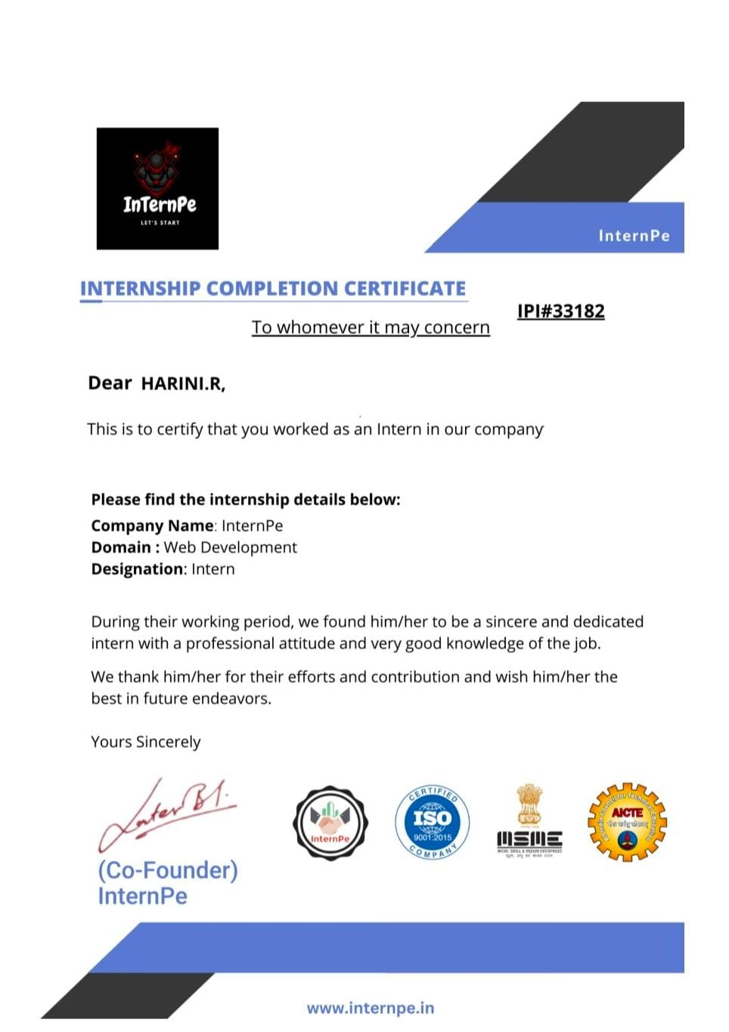
TECHNICAL CERTIFICATION
DEPARTMENT OF COMPUTER APPLICATIONS

Slide 37
REFERENCES
AUTOMATED HOSTEL FACILITY MANAGEMENT SYSTEM WEBSITE Published by: Prof. M. Gudadhe, Ankit Bhoyer, Ashwin Karwade, Vinod Dhaware Department Of Information Technology ,PCE , Nagpur, India -440016, October 2022.
S. S. Al-Ghawi, S. A. Hussain, M. A. A. Rahbi, and S. Z. Hussain, "Automatic toll e-ticketing system for transportation systems," in 2021 3rd MEC International Conference on Big Data and Smart City (ICBDSC), 2021, pp. 1-5.
Evizal, T. A. Rahman, and S. K. A. Rahim, "RFID Vehicle Plate Number (E-Plate) for Tracking and Management System," in 2021 International Conference on Parallel and Distributed Systems, 2020, spp. 611-616.
Hostel Management Published by: Md. Kawsher Mahbub, Amit Das, Sikder Md. Saiful Islam, Bangladesh University of Business and technology - Mar 6 2019.
Web-Based Hostel management System Published by: Elakkiya Up, Sri Ramakrishna Institute of Technology – March 2018.
DEPARTMENT OF COMPUTER APPLICATIONS

Slide 38

DEPARTMENT OF COMPUTER APPLICATIONS

